Slide 1
FRUIT GRADING SYSTEM
Created by
Jaydip Makawana(15CP009)
Drumil Shah(15CP012)
Tejas Bhadresha(15CP014)
Guided by
Dr. U.K.jaliya
pro. M.J.Joshi

Slide 2
Conv2d function
A convolution layer tries to extract higher-level features by replacing data for each (one) pixel with a value computed from the pixels covered by for example , 5×5 filter centered on that pixel.
Conv2d function has 4 parameters.
Input value, weight, strides and padding.
We slide the filter across the width and height of the input and compute the dot products between the entries of the filter and input at each position.

Slide 3
max_pool function
Pooling layers consider a block of input data and simply pass on the maximum value.
Doing this reduce the size of the output.
Pooling layers are often used to regulate the size of the network and keep the system below a computational limit.

Slide 4
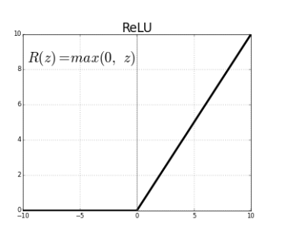
ReLU function
The ReLU is the most used activation function in the world right now. Since, it is used in almost all the convolutional neural networks or deep learning.
the ReLU is half rectified (from bottom). f(z) is zero when z is less than zero and f(z) is equal to z when z is above or equal to zero.
Range: [ 0 to infinity)

Slide 5
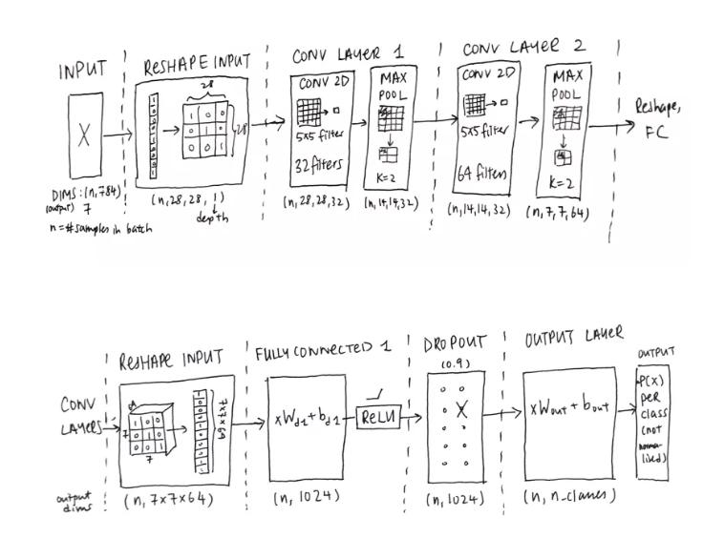
Working of CNN

Slide 6
Classification of dataset
We build a convolution neural network(cnn) to grade the quality of fruit.
In first phase we classify the dataset based on the it’s quality.
First we read an image in grey-scale then resize it.
Give label to each image based on it’s quality.
Then we create two pickle files. One pickle file contain feature and second pickle file contain it’s label.
Pickling is a way to convert a python object into a character stream.

Slide 7
Continue
After writing feature and label into two pickle file.
Then we read these two file , store it into numpy array.
Then converting those numpy array into tensor object.
And feed these two value into model.x and model.y_ placeholders.
Then we take ‘batch_size’ number of images simultaneously to train our model.
We run ‘batch_size’ images and it’s label.
Then we find loss by mean of square of difference.
To optimize the loss ,we have used AdamOptimizer.

Slide 8
Testing
To test first we read an image and convert it into grey scale.
Then load the saved model and do the prediction.

Slide 9
THANK YOU

